Slide 1
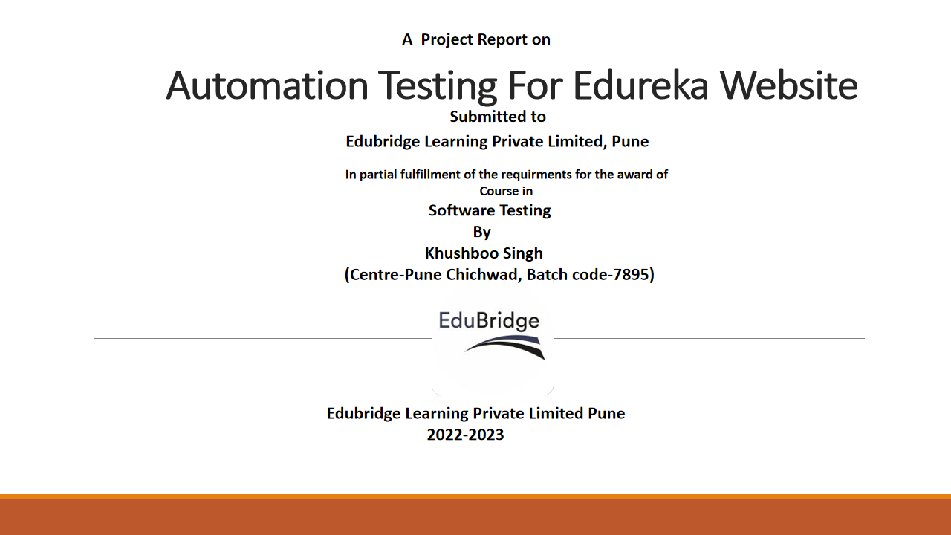

Slide 2
INTRODUCTION
Edureka is an online education and e-learning platform, privately owned and operated by Brain4ce Education Pvt. Ltd.
It creates an informal and productive atmosphere, making education and training easier. Children can absorb subject knowledge while playing games. As a result, schoolchildren of all ages become more responsive and learn efficiently.
eLearning platforms are always flexible. Online learning develops more trust in teacher-student relationships. Students regard the teacher as the sole assessor of their knowledge and abilities in a traditional classroom.
AIM
To do overall testing like functional testing on website to check quality of application.
To improve quality of website and saves time for manually doing this testing.
To check functionalities available on website.

Slide 3

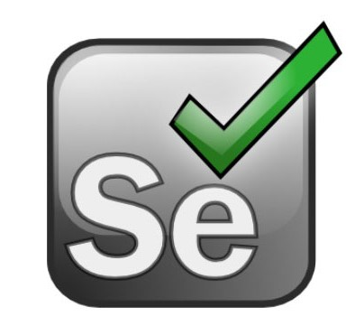

SOFTWARE REQUIRMENTS:
Operating System: Windows 10
Browser: Latest version of Chrome
IDE: Eclipse IDE
Automation Tool: Selenium WebDriver
TOOLS & COMPONENTS:
Selenium is an open-source tool that automates web browsers. It provides a single interface that lets you write test scripts in programming languages like
Ruby, Java, Perl and so on.
Eclipse is a free, Java-based development platform known for its plugins that allow developers to develop and test code written in other programming languages.
The JDK is a development environment for building applications, applets, and components using the Java programming language.

Slide 4
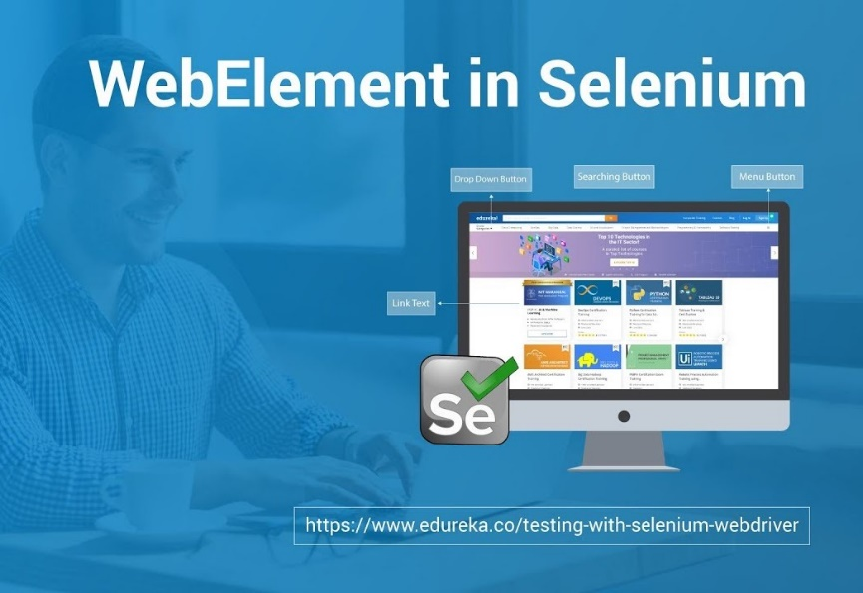
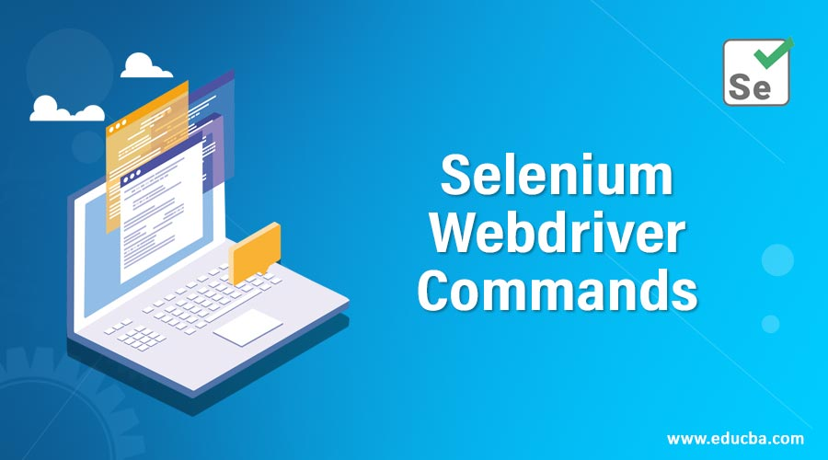
TECHNOLOGY
The term web element refers to a HTML element.
The HTML documents are composed of HTML elements.
It consists a start tag, an end tag and the content in between.
Selenium WebDriver is a web framework that permits you to execute cross-browser tests.
This tool is used for automating web-based application testing to verify that it performs expectedly.
Selenium WebDriver allows you to choose a programming language to create test scripts.

Slide 5
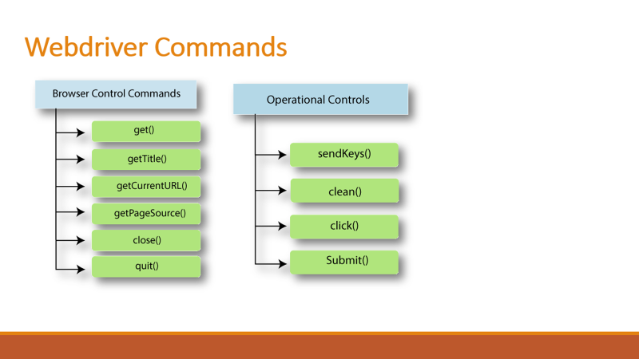

Slide 6
SYSTEM TESTING
Software Testing:
Software is a set of instructions or programs that tell a computer what to do. It can be
divided into two main categories i.e., system software and application software.
System software includes the operating system and all the utilities that help keep the
computer running. Application software includes programs that do specific tasks, such
as word processing or playing games.
Other types of software, including: middleware, driver software, programming
software.
Software testing can be divided into two steps:
1) Verification: it refers to the set of tasks that ensure that the software correctly
implements a specific function.
2) Validation: it refers to a different set of tasks that ensure that the software that has been built is traceable to customer requirements.
Black box
Black box testing is a type of software testing in which the functionality of the software is not known. The testing is done without the internal knowledge of the products.

Slide 7
White box Testing
White box testing techniques analyze the internal structures the used data structures,
internal design, code structure and the working of the software rather than just the
functionality as in black box testing. It is also called glass box testing or clear box
testing or structural testing.
Gray Box Testing
Gray Box Testing is a software testing technique which is a combination of Black Box
Testing technique and White Box Testing technique. In Black Box Testing technique,
tester is unknown to the internal structure of the item being tested and in White Box
Testing the internal structure is knownto tester. The internal structure is partially
known in Gray Box Testing. This includes access to internal data structures and algorithm for purpose of designing the test cases.
Types of Testing
1 Functional testing: Functional testing is a kind of black-box testing that is performed to confirm that the functionality of an application or system is behaving as expected. It is done to verify all the functionality of an application.
2 Unit testing: the application is ready and given to the Test engineer, he/she will start checking every component of the module or module of the application independently or one by one, and this process is known as Unit testing.
3 Sanity testing: Testing that is done to ensure that all the major and vita functionalities of the application/system are working correctly. This is generally done after a smoke test.

Slide 8
4 Smoke testing: Testing that is done after each build is released to test to ensure build stability. It is also called as build verification testing.
5 Regression testing: Testing performed to ensure that adding new code,enhancements, fixing of bugs is not breaking the existing functionality or causing any instability and still works according to the specifications.
Regression tests need not be as extensive as the actual functional tests but should ensure just the amount of coverage to certify that the functionality is stable.
6 Integration testing: When the system relies on multiple functional modules that might individually work perfectly, but have to work coherently when clubbed together to achieve an end to end scenario, validation of such scenarios is called
Integration testing.
7 Beta/Usability Beta/Usability testing: Product is exposed to the actual customer in a production like an environment and they test the product. The user’s comfort is derived from this and the feedback is taken. This is similar to that of User Acceptance testing.
8 Non-functional testing: Non-functional Testing is a type of Software Testing that is performed to verify the non-functional requirements of the application. It verifies whether the behavior of the system is as per the requirement or not.
9 Performance testing: A type of testing to ensure that a software program or system meets specific performance goals, such as response time or throughput.
10 Load testing: A type of testing to ensure that a software program or system can handle a large number of users or transactions.
11 Security testing: A type of testing to ensure that a software program or system is secure from unauthorized access or attack.
12 Scalability testing: A type of testing to ensure that a software program or system can be scaled up or down to meet changing needs.
13 Stress testing: A type of testing to ensure that a software program or system can handle an unusually high load.

Slide 9
14 Usability testing: A type of testing to ensure that a software program or system is easy to use.
15 Volume testing: A type of testing to ensure that a software program or system can handle a large volume of data.
Automation Testing Using Selenium
package Edureka;
import java.time.Duration;
import org.openqa.selenium.By;
import org.openqa.selenium.WebDriver;
import org.openqa.selenium.WebElement;
import org.openqa.selenium.chrome.ChromeDriver;
import org.openqa.selenium.interactions.Actions;
public class EdurekaSeleniumProj {
public static void main(String[] args) throws InterruptedException {
// TODO Auto-generated method stub
System.setProperty("webdriver.chrome.driver","C:\\Program Files\\chromedriver.exe");

Slide 10
WebDriver driver=new ChromeDriver();
//Launch The Edureka Website
driver.get("https://www.edureka.co/signin");
driver.manage().window().maximize();
driver.manage().deleteAllCookies();
String str = driver.getTitle();
System.out.println("The title of the page is:" +str);
String str1=driver.getCurrentUrl();
System.out.println("The Current url of the page is :"+str1);
driver.navigate().forward();
// To enter text into textbox
driver.findElement(By.id("si_popup_email"));
WebElement ename=driver.findElement(By.id("si_popup_email"));
ename.sendKeys("khushiraj0726@gmail.com");
//Window sleep or hold for few second
Thread.sleep(5000);
driver.findElement(By.id("si_popup_passwd"));
WebElement password=driver.findElement(By.id("si_popup_passwd"));
password.sendKeys("Rashi@5933");

Slide 11
// How to click element
driver.findElement(By.xpath("//*[@id=\"new_sign_up_optim\"]/div/div/div[2]/div[3]/form/button")).click();
Thread.sleep(5000);
//To searchBar
driver.findElement(By.className("open_search_overlay")).click();
Thread.sleep(5000);
driver.findElement(By.id("search-input")).sendKeys("Certification Courses & Master Programs");
Thread.sleep(5000);
driver.findElement(By.xpath("/html/body/div[5]/section[1]/div/span[1]/div/div/div/ul/li[2]/a"));
Thread.sleep(5000);
//click logo for Home page
driver.findElement(By.xpath("/html/body/header/nav/div[2]/a/img")).click();
Thread.sleep(5000);
//For Profile
driver.findElement(By.className("img30")).click();
Thread.sleep(5000);
// Select for my profile
driver.findElement(By.xpath("/html/body/header/nav/div[4]/ul/li[6]/ul/li[4]/a")).click();
Thread.sleep(5000);

Slide 12
//iFrame
java.util.List<WebElement>iframes = driver.findElements(By.tagName("iframe"));
System.out.println("Number of i frames:"+iframes.size());
String currentWindowHandle = driver.getWindowHandle();
System.out.println("Current window handle:"+currentWindowHandle);
Thread.sleep(2000);
//Counting Frames
//driver.switchTo().frame(20);
//driver.switchTo().frame(1);
// driver.switchTo().frame("iframe");
//driver.switchTo();
//for logout
driver.findElement(By.xpath("/html/body/app-root/app-profile-main/section/div/div/div[1]/span[1]/a")).click(
);Thread.sleep(5000)
;
driver.findElement(By.className("img30")).click()
;Thread.sleep(5000
);
driver.findElement(By.xpath("/html/body/header/nav/div[4]/ul/li[6]/ul/li[12]/a")).click();
Thread.sleep(5000);

Slide 13
driver.manage().timeouts().implicitlyWait(Duration.ofSeconds(10));
driver.manage().timeouts().pageLoadTimeout(Duration.ofSeconds(10));
driver.manage().timeouts().implicitlyWait(Duration.ofSeconds(10));
driver.navigate().forward();
driver.navigate().back();
driver.navigate().refresh();
driver.close();
driver.quit();
}
}

Slide 14
CUCUMBER
Feature file for login amazon
Feature: User tries to login to amazon.com with valid credentials
Scenario: Valid login
Given I am a user of amazon.com
When I log in using valid credentials
Then I should be logged in
Scenario: Invalid login
Given I am a user of amazon.com
When I log in using invalid credentials
Then I should not be logged in
Steps definition file for login amazon
package StepDefinationFile;
import org.openqa.selenium.By;
import org.openqa.selenium.WebDriver;
import org.openqa.selenium.chrome.ChromeDriver;
import io.cucumber.java.en.Given;

Slide 15
import io.cucumber.java.en.Then;
import io.cucumber.java.en.When;
public class LoginSteps {
WebDriver driver;
@Given("I am a user of amazon.com")
public void i_am_a_user_of_amazon_com() throws InterruptedException {
System.setProperty("webdriver.chrome.driver","C:\\Program Files\\chromedriver.exe");
WebDriver driver=new ChromeDriver();
driver.get("https://www.amazon.com");
Thread.sleep(2000);
}
@When("I log in using valid credentials")
public void i_log_in_using_valid_credentials() {
driver.findElement(By.id("nav-link-accountList")).click();
driver.findElement(By.id("ap_email")).sendKeys("rajkhushboo2608@gmail.com");
driver.findElement(By.className("a-button-input")).click();
driver.findElement(By.id("ap_password")).sendKeys("Rashi@5933" );
} @Then("I should be logged in")
public void i_should_be_logged_in() {
driver.findElement(By.id("signInSubmit")).click();
}

Slide 16
@When("I log in using invalid credentials")
public void i_log_in_using_invalid_credentials() {
driver.findElement(By.id("nav-link-accountList")).click();
driver.findElement(By.id("ap_email")).sendKeys("rajkhushboo2608@gmail.com");
driver.findElement(By.className("a-button-input")).click();
driver.findElement(By.id("ap_password")).sendKeys("Amazon710");
}
@Then("I should not be logged in")
public void i_should_not_be_logged_in() {
driver.findElement(By.id("signInSubmit")).click();
}
}

Slide 17
CONCLUSION
The project entitled EDUREKA Website was completed successfully. The system has been developed with much care and free of errors and at the same time it is efficient and less time consuming.
We learned how to test different features of a project.
There is a scope for further development in our project to a great extend. A number of features can be added to this system in future like providing.

